Slide 1
COMP1003 – Algorithms, Data Structures and Mathematics Lecture 17 Stacks and Queues (using Arrays)
Thomas Wennekers
University of Plymouth

Slide 2
Main Ideas
Abstract data types (ADTs) implement certain generic functionality on collections of other data types.
A Stack is a last-in-first-out memory (LIFO)
A Queue is a first-in-first-out memory (FIFO)

Slide 3
Why is this important ?
Stacks and Queues are omnipresent in computer programming
Queues can hold all kinds of things that have to be processed in the order they arrive: internet packages, emails, GUI events, system threads...
Stacks are often used for short-term storage of objects. In 3D rendering transformation matrices go on a stack; running programs have a run-time stack for parameters and local variables of function calls.

Slide 4
Aims and Objectives
To understand the principle of data abstraction
To learn the basic functionality and operations that stacks and queues provide
To implement stacks and queues using arrays

Slide 5
Outline
Abstract data types
Static versus dynamic types
A static stack using an array
A static queue using a ring buffer

Slide 6
Data Abstraction

Slide 7
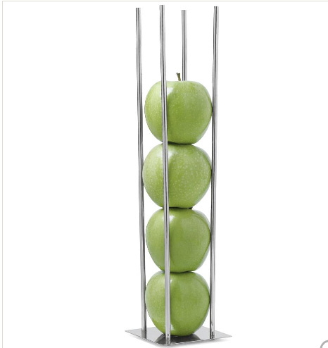




Stacks
What are the main characteristics & operations ?

Slide 8
Stacks
Last-in-first-out principle; push, pop, size ...

Slide 9


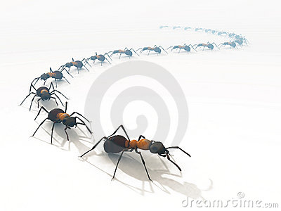
Queues
First-in-first-out principle; append, remove, size ..

Slide 10
Abstract Data Types (ADTs)
Structures that can hold collections of data of some type (that type does not matter at all)

Slide 11
Abstract Data Types (ADTs)
Structures that can hold collections of data of some type (that type does not matter at all)
Functionality independent of concrete data type
Functions typically provided: insert, delete, search, size, isEmpty, …

Slide 12
Abstract Data Types (ADTs)
Structures that can hold collections of data of some type (that type does not matter at all)
Functionality independent of concrete data type
Functions typically provided: insert, delete, search, size, isEmpty, …
Some ADTs:
Set, Stack Queue, List, Tree, Graph …

Slide 13
Abstract Data Types (ADTs)
Structures that can hold collections of data of some type (that type does not matter at all)
Functionality independent of concrete data type
Functions typically provided: insert, delete, search, size, isEmpty, …
Some ADTs:
Set, Stack Queue, List, Tree, Graph …
Programming languages provide a wide range

Slide 14
Abstract Data Types (ADTs)
Structures that can hold collections of data of some type (that type does not matter at all)
Functionality independent of concrete data type
Functions typically provided: insert, delete, search, size, isEmpty, …
Some ADTs:
Set, Stack Queue, List, Tree, Graph …
Programming languages provide a wide range
but you are not allowed to use them in COMP1003

Slide 15
COMP1003 is about how data types
work and are implemented

Slide 16
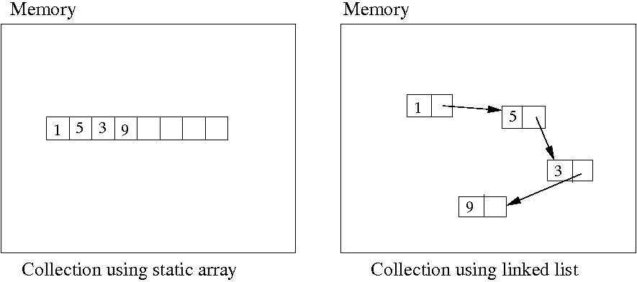
Static versus Dynamic Implementations
Dynamically linked structures are more flexible, but perhaps also a little more difficult to understand

Slide 17
A Stack using an Array

Slide 18
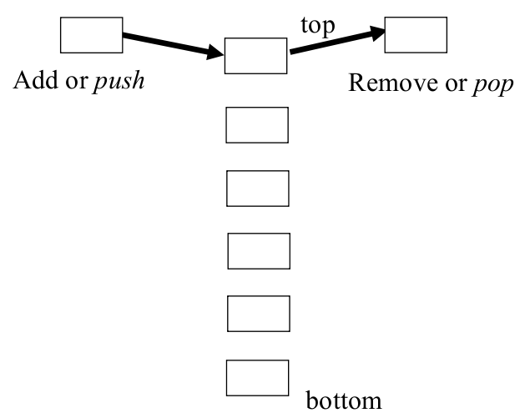
Stack ADT
push/add
pop/remove
peek/top
isEmpty
size
...

Slide 19
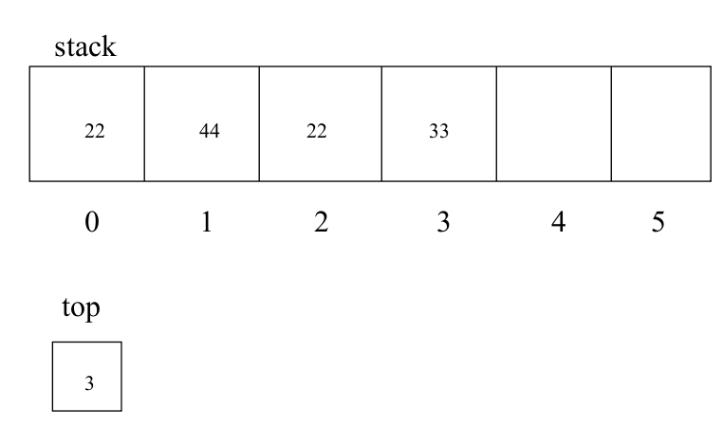
Stack with static Array (for int)

Slide 20
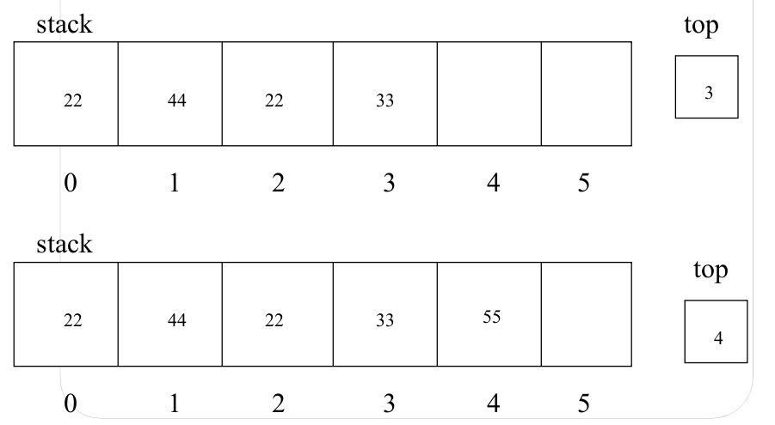
Before and After push (55)

Slide 21
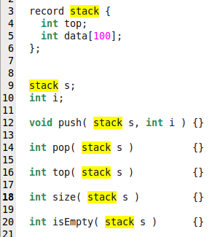
Array-Stack Outline
"record" could also be "class"
new instance "s" of stack
some basic operations on stacks

Slide 22
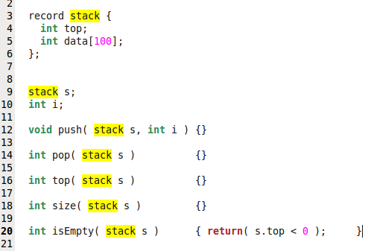
Fill in (Pseudo-)Code

Slide 23
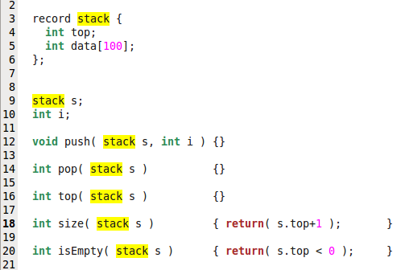
… and more ...

Slide 24
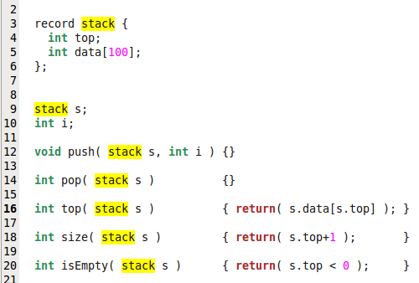
… and more ...

Slide 25
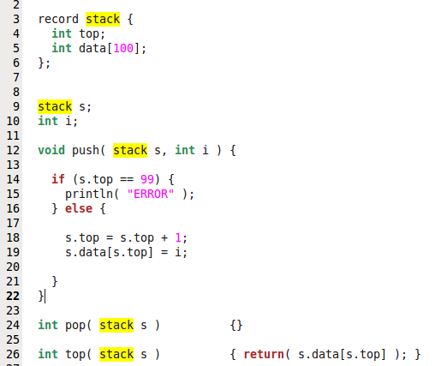
Push to Stack

Slide 26
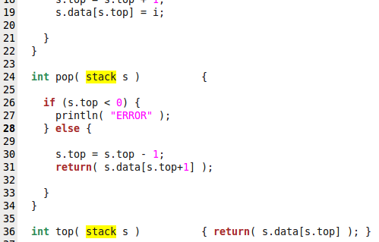
Pop from Stack

Slide 27
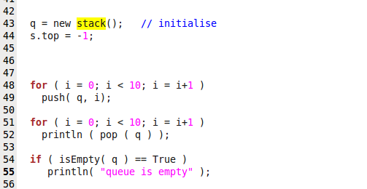
… and some testing

Slide 28
A queue using a "ring buffer"

Slide 29
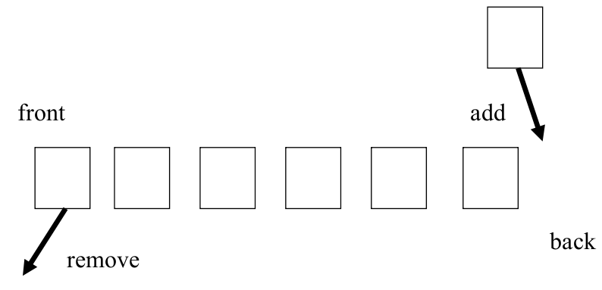
Queue ADT
Operations: add, remove, size, isEmpty, ...

Slide 30
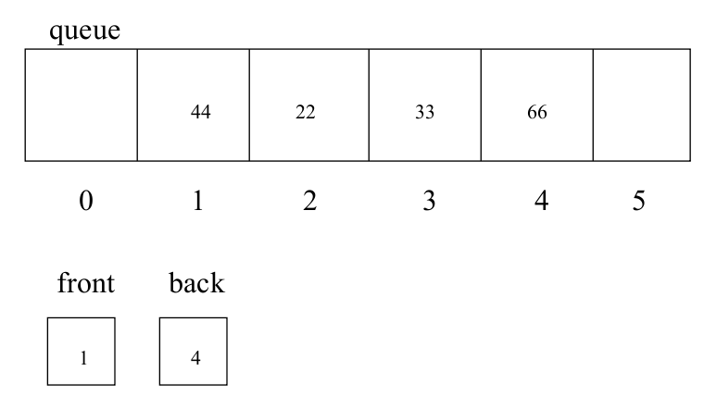
Queue in Array
… remove 44 … remove 22 ...

Slide 31
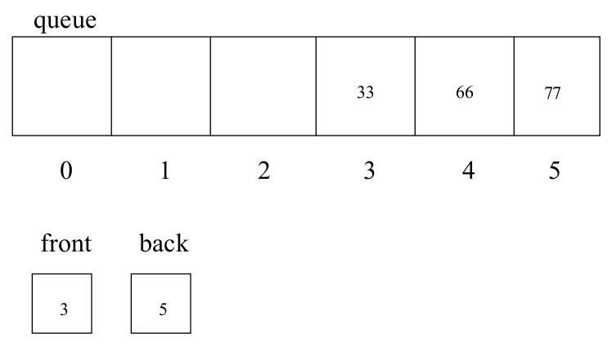
After add(77) → Array end reached
Could shuffle all the data left? → Inefficient

Slide 32
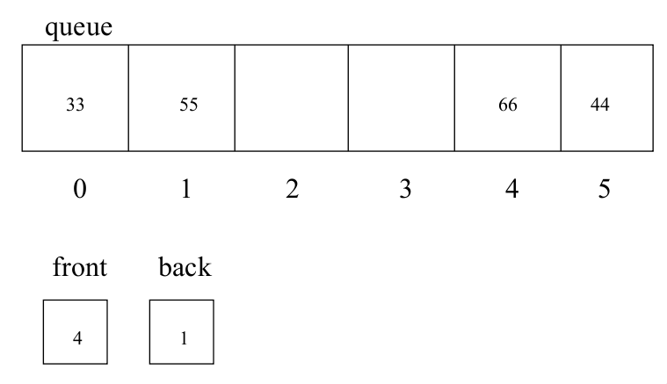
Ring-buffers wrap around

Slide 33
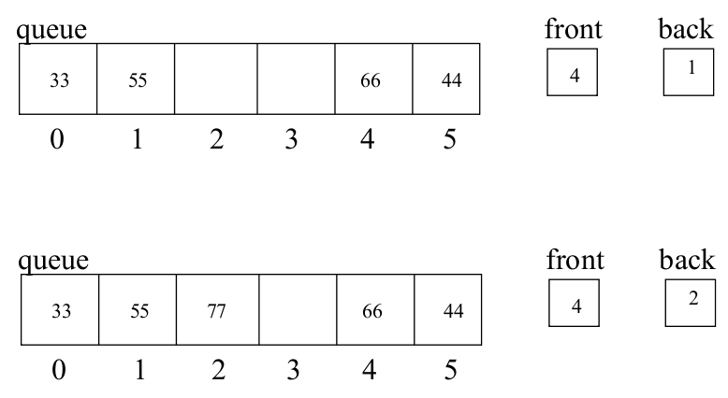
Before and After add(77) in Standard Situation

Slide 34
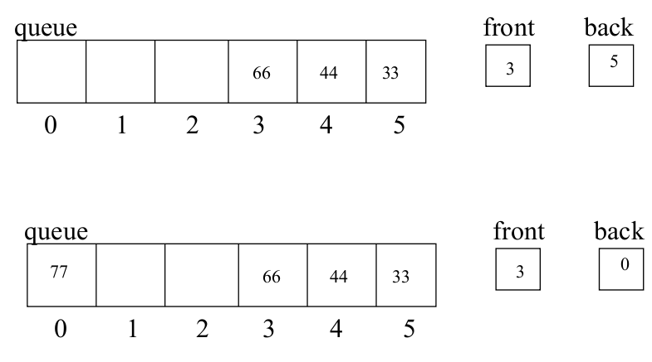
Before and After Wrapping
Wrapping around happens seldom and is efficient!

Slide 35
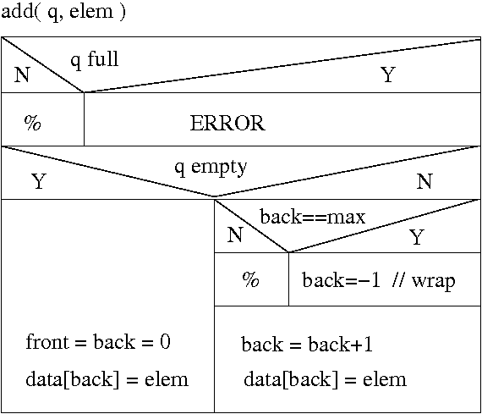
Add - Structogram

Slide 36

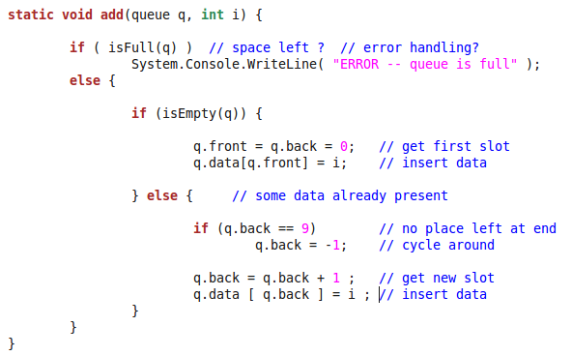
Add – C# Implementation

Slide 37
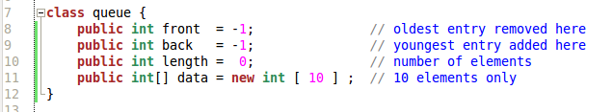
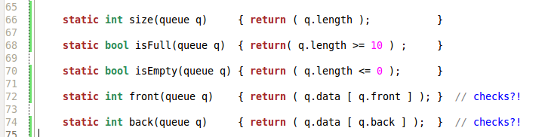
C# Implementation with Length
length-variable makes some operations very short

Slide 38
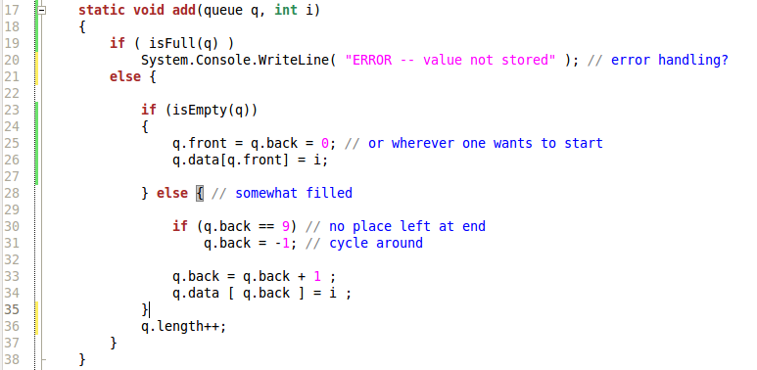
Add – C# Implementation with 'length'

Slide 39
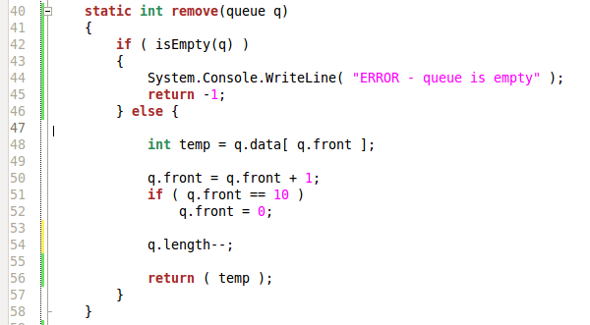
Remove – C# Implementation

Slide 40
More in the labs (including code)

Slide 41
Outcomes
Concept of abstract data types (ADTs) that implement certain generic functionality on top of collections of other data types
Basic Stack implementation
Basic Queue implementation (ring buffer)

